Slide 1
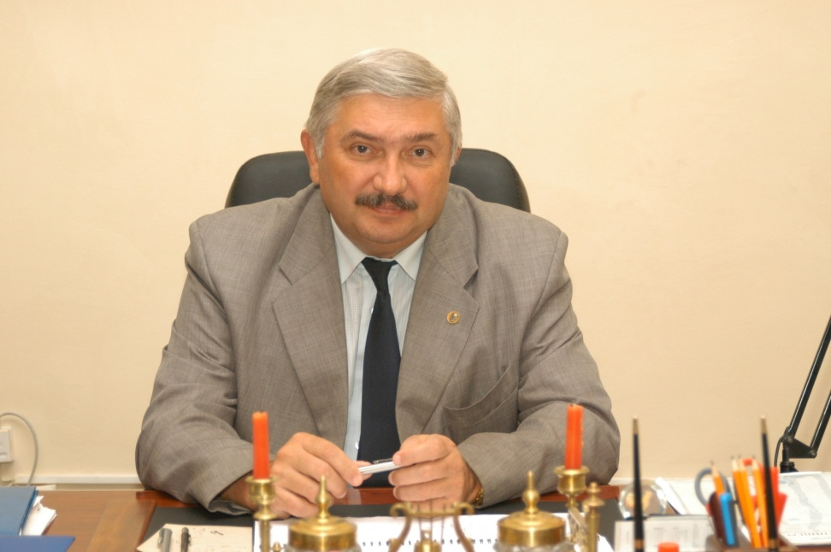
Yaroslavl State Pedagogical University named after K.D.Ushinsky

Slide 2
Yaroslavl State Pedagogical University named after K.D. Ushinsky (YSPU) is one of the oldest Russian Universities. Its history dates back to 1908.
Today the University is a leading higher educational institution of the Upper-Volga region with 10000 students. It is a multi-discipline educational institution training students in 80 majors (bachelor’s and master’s programs).
It occupies the fifth place among the best Pedagogical Universities in Russia.
There are 3 Institutes, 10 faculties and 56 departments in the University. The University has 7 Dissertation Councils.
In its structure the university has ten faculties: the Law Faculty, the Mathematics Faculty, the Physics Faculty, the Economics Faculty, the History Faculty, the Faculty of Information and Computer Science, the Faculty of Social and

Slide 3
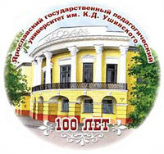
The YSPU collaborates with the universities, scientific and cultural centres and organizations of 35 countries of the world. The University participates in international projects financed by such organizations as The Council of Europe, The EU, The British Council, The Foundation of Robert Bosh, DAAD and others. The University maintains contacts and has joint projects with different organizations, colleges and universities of the U.S.A.

Slide 4
The university has been successfully pursuing strategic goals of internationalization. International collaboration comprises student and faculty exchange, internships, joint research work and publications, tailored programs.

Slide 5
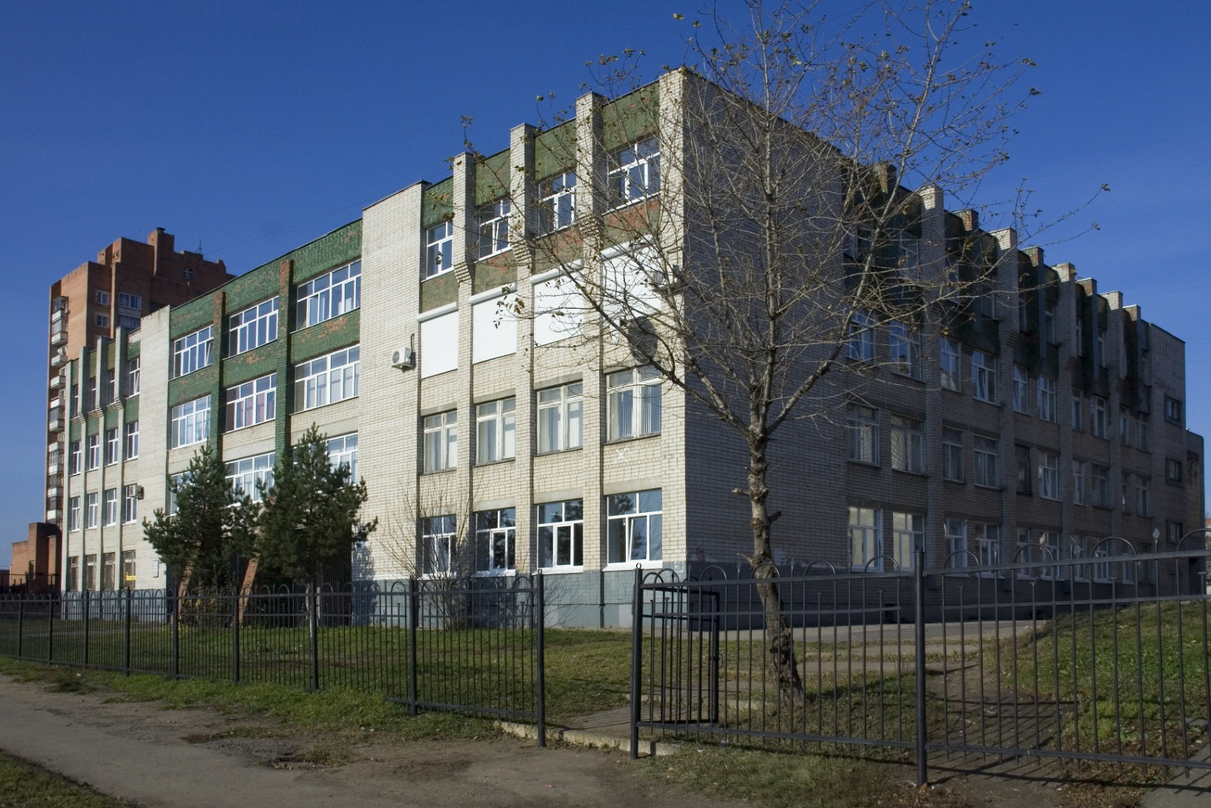
The Institute of Philology consists of two faculties: the Faculty of Foreign Languages and the Faculty of Russian Philology and Culture where more than 1600 students study.

Slide 6
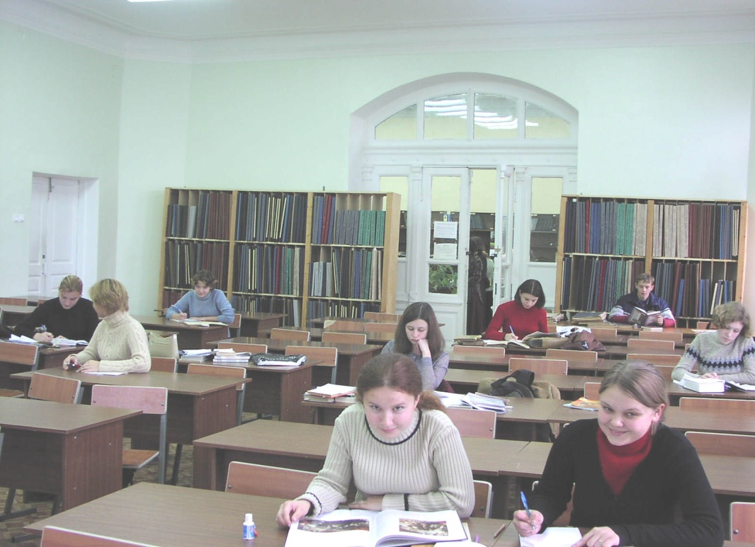
At the Faculty of Foreign Languages students are trained in Modern European Languages (English, German, French, Spanish, Italian) as well as Linguistics and Intercultural Communication, Translation and Theory of Translation, Theory and Methods of Intercultural Communication, Theory and Methods of Teaching Foreign Languages and Cultures.

Slide 7
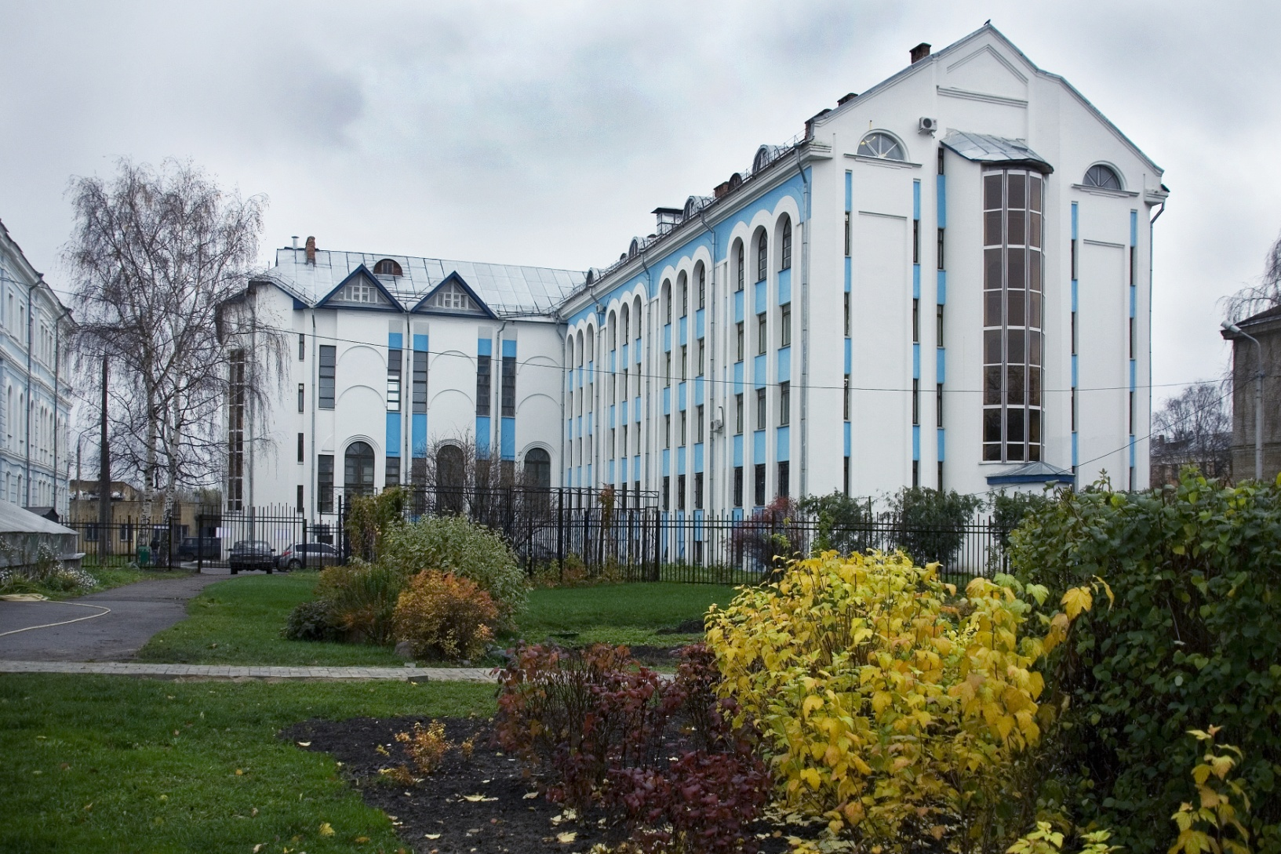
The University heads the Association of the Continuous Pedagogical Education. Colleges that are situated in the Yaroslavl, Vologda, Tver, Arkhangelsk regions and those of the Republic of Komi, branches of the YSPU in Uglich, Rybinsk and Rostov are members of this organization.

Slide 8
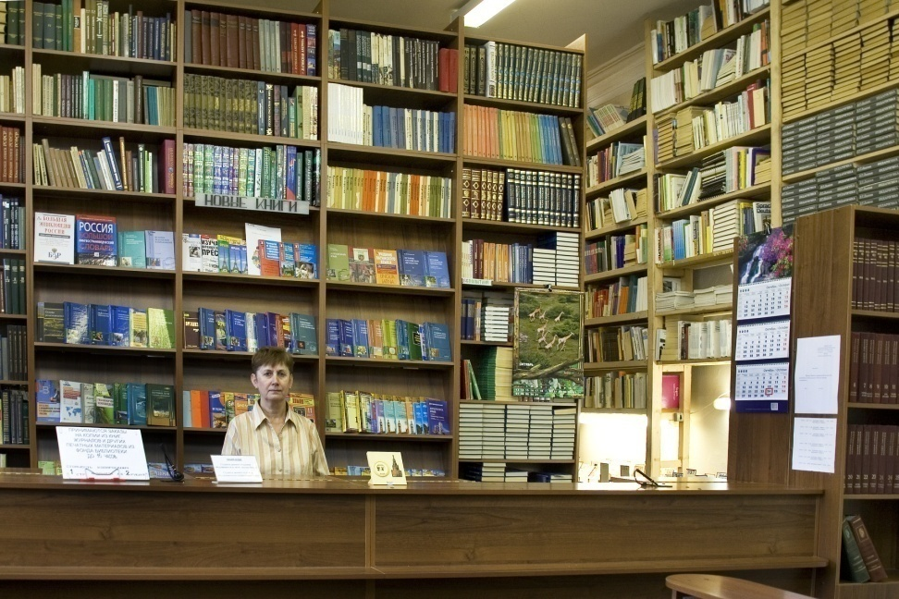

Teachers of foreign languages are also trained at the Faculties of History, Mathematics and Pedagogical Faculty

Slide 9
Master’s Programs
The first Master’s programs were introduced in the YSPU in 1996;
7 Faculties have 27 Master’s programs in several majors now;
The Faculty of Foreign Languages trains students in the fields of “Foreign Languages”, “Education in the field of Foreign Languages”, “Management in Education”, “Tutoring in General and Professional Education”.

Slide 10
Advantages of Master’s Programs
A two-level system of education which corresponds to international standards;
Profound professional training based on new educational programs;
Collaboration with partners all over the world in the field of the implementation of educational programs;
Research work in special laboratories;
Individual path of learning under the supervision of a research manager;
Possibility to change the direction of training and have a Bachelor's Degree in one major and a Master’s Degree in a different one.

Slide 11
Association of teachers of foreign languages
Teachers of foreign languages in the region have their own Association under the guidance of the Faculty of Foreign languages.
They discuss new standards, programs, curricula, methods of teaching languages.
They can get in-service training there.

Slide 12
Areas of work at the Faculty of Foreign Languages
Training intending teachers;
Working out new programs, plans and methods of teaching;
Support of “Teachers’ Association;
Collaboration with schools, colleges in the Association of the Continuous Pedagogical Education;
Research work in in the field of foreign languages and methods of teaching them;
Collaboration with partners in Russia and abroad;

